Slide 1
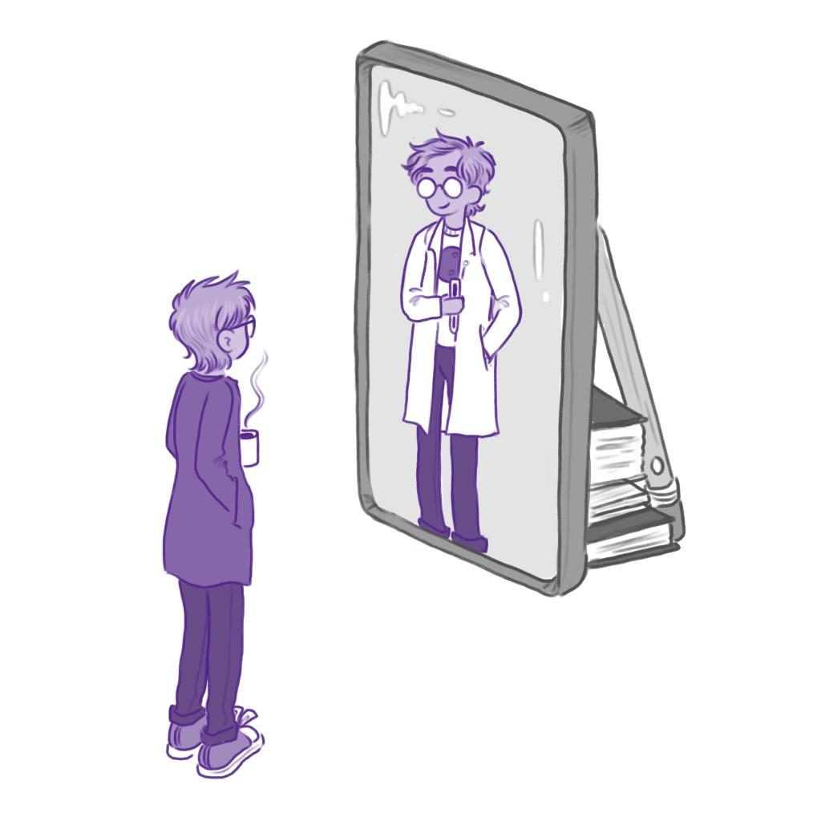
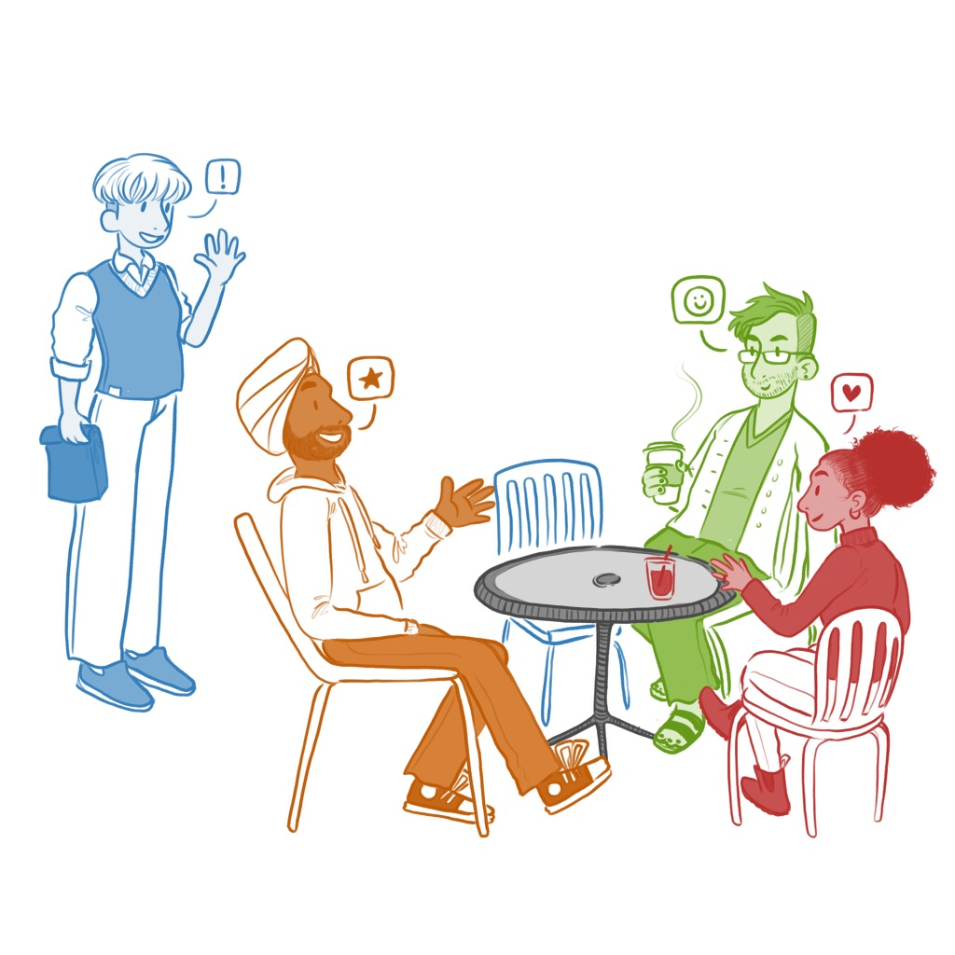
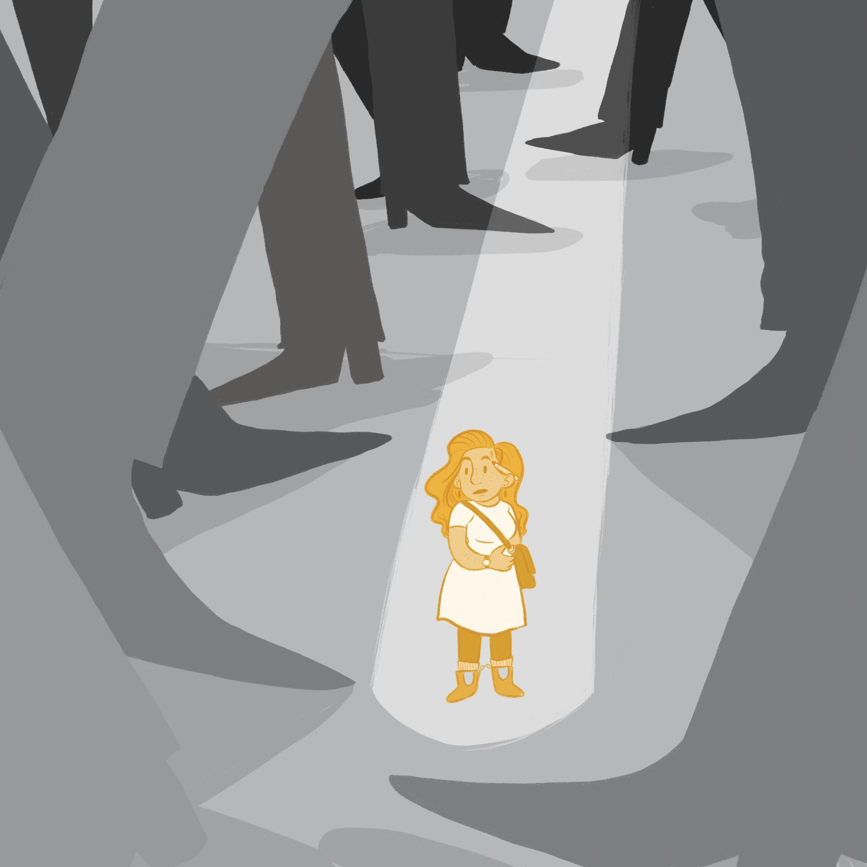
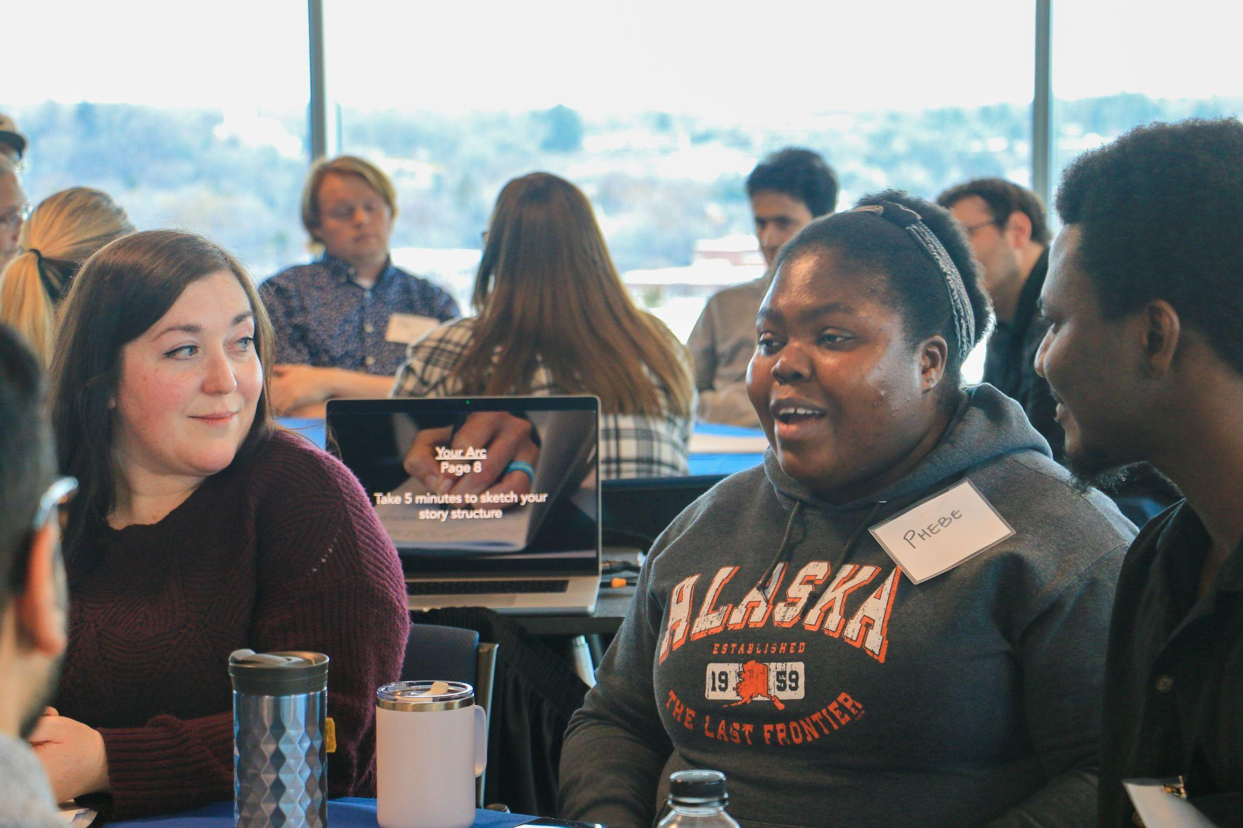
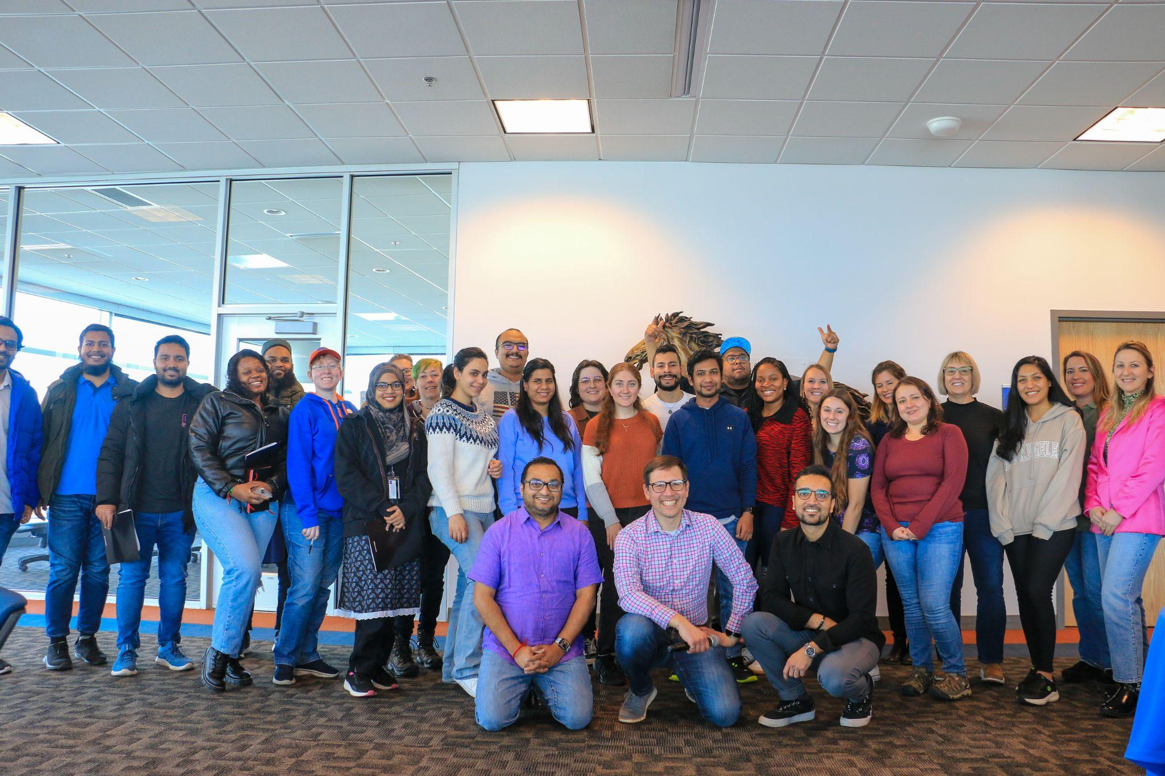
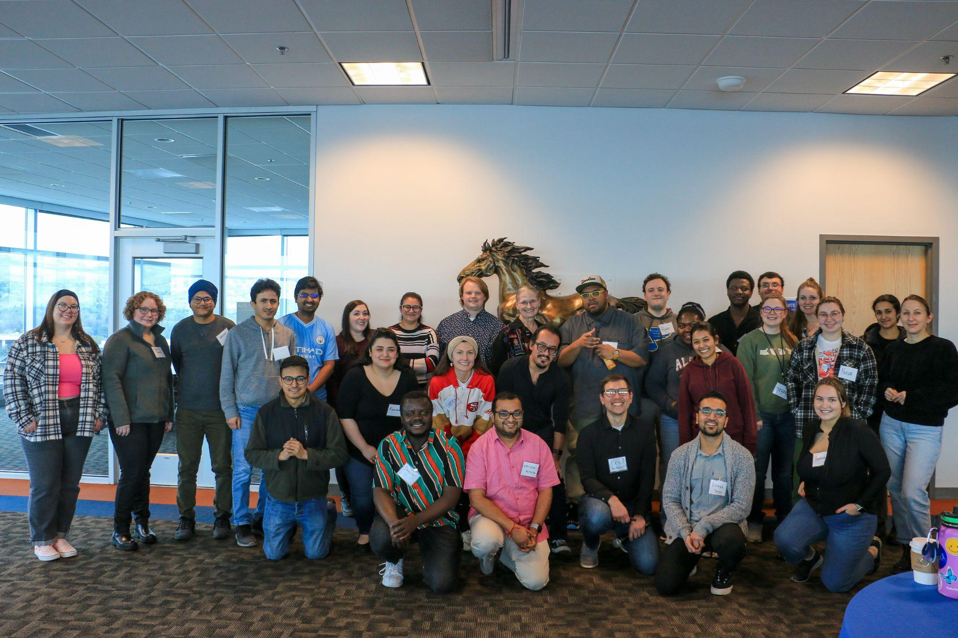
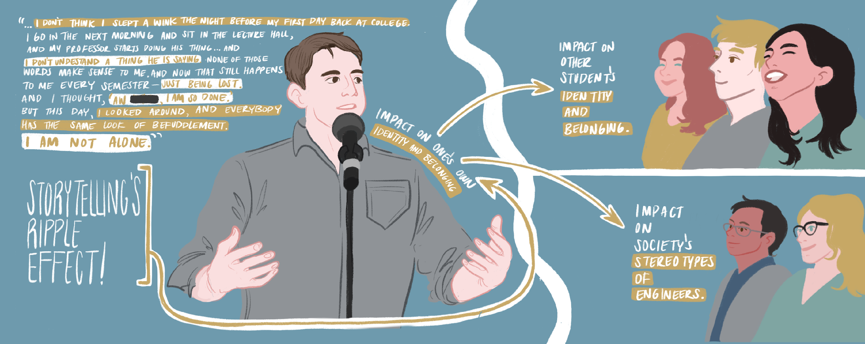
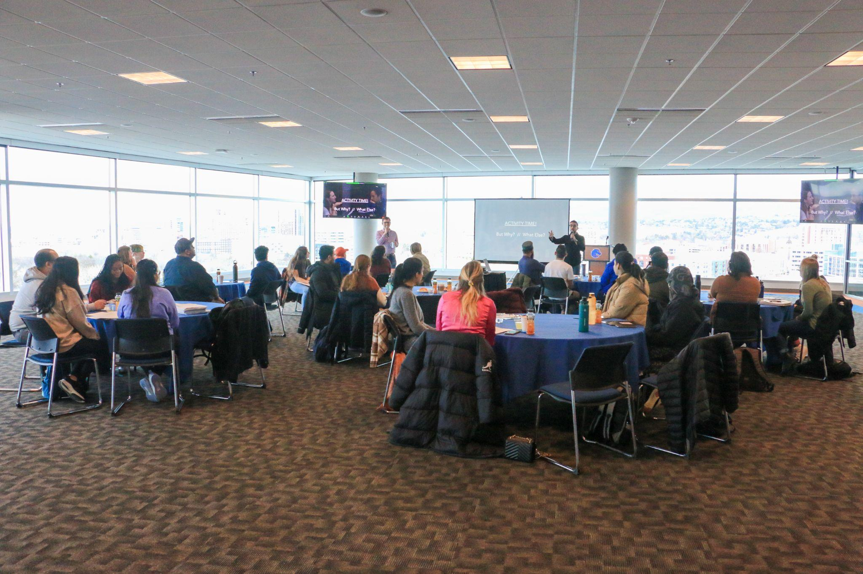
Empowering STEM Voices: A Storytelling Approach to Enhancing Professional Identity and Belonging in Graduate Education
Krishna Pakala
Angela Minichiello, Eric Jankowski, Anne Hamby and Jelena Pokimica
During the 3-year project, we will use a design-based research approach to design and iteratively implement, assess, and refine the intervention over three annual cycles. We will collect and analyze mixed methods (i.e., quantitative and qualitative) data, including participants’ stories, focus group interviews, and self-report measures related to professional identity, sense of belonging, and impostor phenomenon. We will also survey event attendees to identify the professional identities of other students in the audience and examine how hearing student stories affects stereotypes people hold about STEM professionals.
INTRODUCTION
This project aims to enhance graduate student retention in STEM fields by implementing a transformative storytelling intervention. The interdisciplinary research team, collaborating with The Story Collider, will leverage Self Determination Theory to empower students in shaping their professional identity. By addressing challenges like imposter syndrome and underdeveloped professional identities, the intervention aims to improve program completion and facilitate STEM workforce transition. The study will also explore how personal storytelling impacts existing STEM stereotypes. Project outcomes will include study findings, best practices, and open-source storytelling curricula.
Sense of Belonging
Professional Identity
Impostor Phenomenon
Workshop on storytelling exploration
brainstorm personal events —> consequences —> character and identity —> narrative arcs —> integration of science into narratives
—> practicing with partners —> impactful beginnings and endings
We will use a mixed method approach to answer three project research questions.
(1) What are the thematic and structural characteristics of personal narratives that students write about their experiences in STEM graduate education? (Qualitative)
(2) How does the development and performance of each student’s personal narrative about experiences in STEM graduate education each relate to (a) professional identity, (b) sense of belonging in the graduate program, and (c) feelings of being an impostor? (Quantitative)
(3) How do the thematic and structural characteristics of personal narratives that students write about their experiences in STEM graduate education relate to (a) professional identity,
(b) sense of belonging in their graduate program, and (c) feelings of being an impostor? (Mixed)
Our team impacted 50 STEM graduate students recently on Feb 5 and 6, 2024. Through storytelling coaching, students delved into themes of discovery, fitting in, and overcoming doubt in STEM. https://boi.st/3PKCiYR
Feedback from 48 participants revealed a strong likelihood of recommendation, with 54% very likely and 38% likely to recommend. Only 6% were somewhat likely, and 2% somewhat unlikely to recommend.
They particularly appreciated the group sharing aspect, expressing anticipation in refining their stories. Positive feedback extended to the art of storytelling techniques, especially integrating stories into scientific talks, and praise for the workbook featuring story arc graphs.
The practical and interactive nature of the workshop, along with opportunities to practice concepts in groups, received favorable remarks. Additional highlights included the incorporation of research papers, peer-to-peer interaction, small group story refinement, and the dynamic workshop structure. Examples, snacks, breaks, and interactive sessions with different partners were also noted as positive aspects.
Acknowledgement: “This material is based upon work supported by the National Science Foundation under Grant IGE:2325041.”
Disclaimer: “Any opinions, findings, and conclusions or recommendations expressed in this material are those of the author(s) and do not necessarily reflect the views of the National Science Foundation.”

