Slide 1

Applying Cognitive Theories of
Learning to Improve Graduate
Training in STEM Communication
Elise Demeter (PI) & Adam Reitzel (Co-PI)
UNC Charlotte
NSF IGE Award #2325453
Notes:
Elise

Slide 2
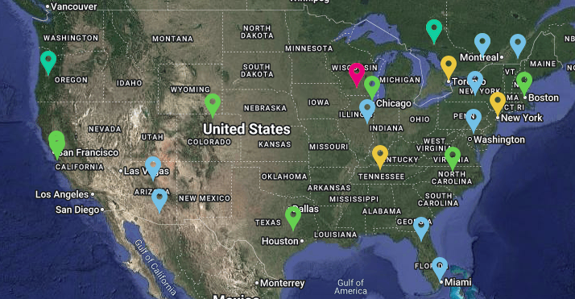
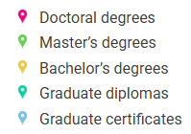
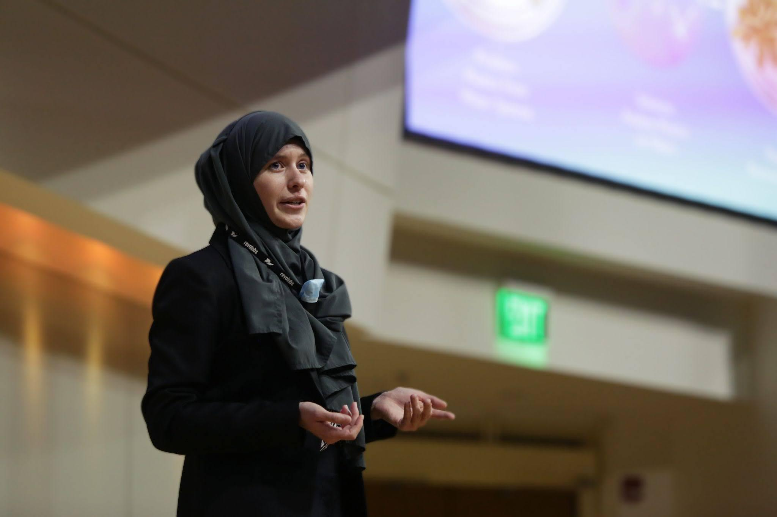

Science Communication Programs Remain Rare
Source: Global Network for Science Communication
14-26 Sci Comm Programs in the United States
Most are certificates or Bachelor’s degrees
More places offer limited opportunities (workshops, bootcamps, 3MT competitions)
Notes:
Adam
Science communication programs remain rare in the US, despite the importance of this training and student interest in the topic. More often you find ad-hoc workshops, bootcamps, or competitions like the 3 minute thesis. To increase access to graduate-level stem communication training, we created a series of asynchronous, online mini-courses, as this type of content is easily scaled and shareable to other institutions.

Slide 3
Hypothesis & Rationale
We hypothesized grounding our curriculum in cognitive science principles would help make our students better STEM communicators.
Why?
Because it enables students to tailor their messaging
to how people actually process, retain & apply information.
Notes:
Elise

Slide 4
Research Questions
How does grounding STEM communication training in cognitive science improve students’ learning and skill transfer?
What is the impact of expert-created, short‑course training on students’ perceived STEM communication abilities & confidence?
How effectively do authentic, public‑oriented deliverables demonstrate students’ mastery of STEM communication outcomes?
Notes:
Elise

Slide 5
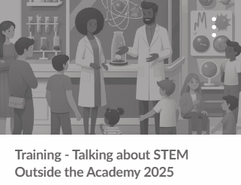
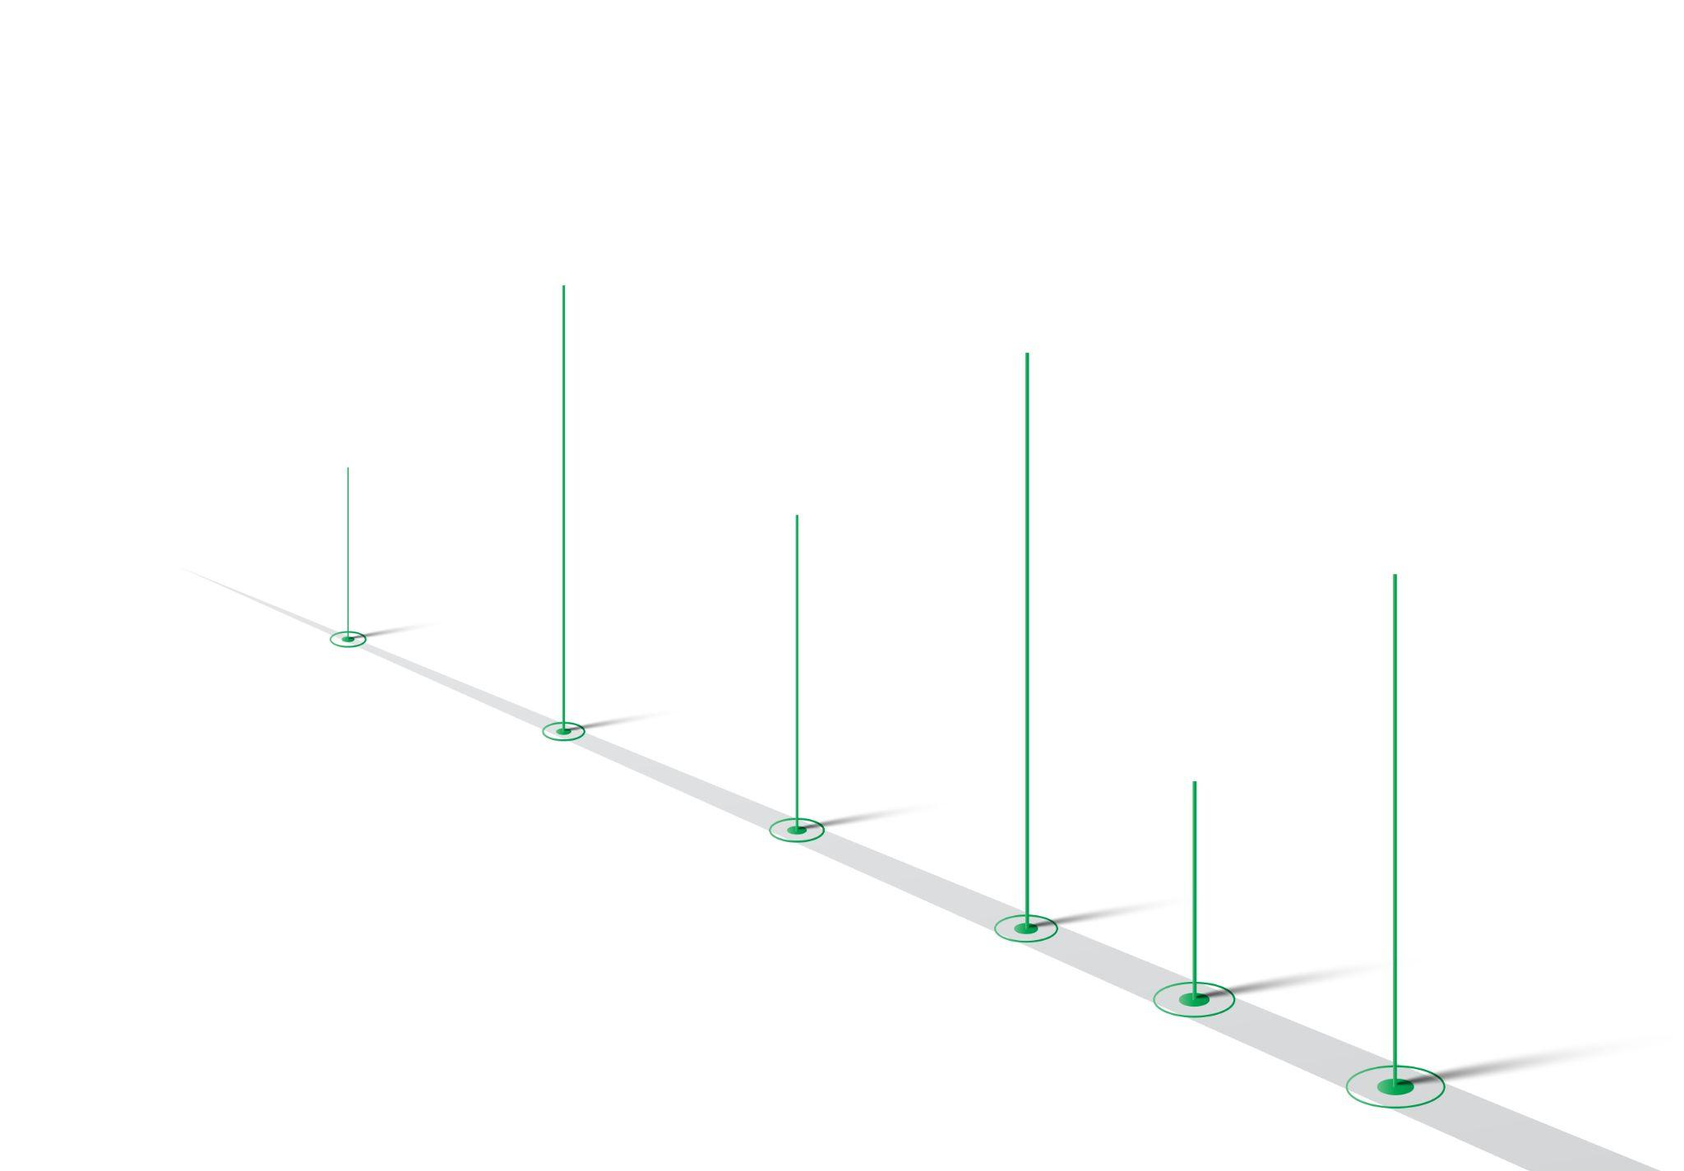
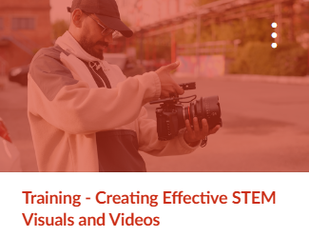
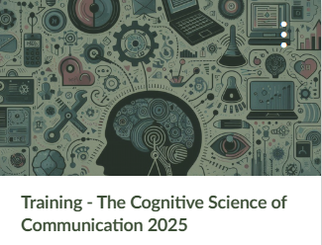
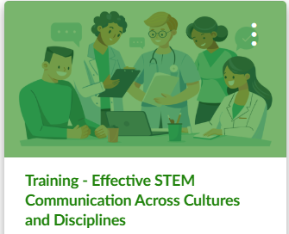
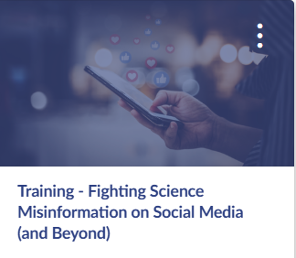

Overview of Academic-Year Program
Asynchronous training in Canvas
Each course is 4 weeks
August kick-off
Sept
Oct
Nov
Study design:
Students randomly assigned to ‘Cognitive Science of Comm.’ or ‘Science of Comm.’ for 1st course.
Jan
Feb - March
April
Notes:
Elise
To answer these questions, we designed a series of noncredit training courses, each paced over 4 weeks. The short courses were delivered asynchronously in our LMS. Half of our students started their training in a Cognitive Science of Communication course. The other half began in a more generic science of communication course. The students were then put into different sections of the remaining 5 courses, which spanned the academic year.

Slide 6
Overview of Courses
01. Cognitive Theories of Communication
OR Science of Communication
Doug Markant
Assistant Professor of Psychology, UNC Charlotte
Final product: Infographic
04. Effective STEM Writing for Expert and General Audiences
Angela Chen Managing Editor at Asterisk Magazine, formerly editor at Vox, Wired
Final product: Op-Ed essay
02. Talking About STEM Outside the Academy
Gabor Zsuppan
Discovery Place Museum, Charlotte, NC
Final product: STEM explainer video
05. Creating Effective STEM Visuals and Videos
Tom McNamara
Freelance Director/Editor/Videographer/Reporter
Final product: STEM social media video
03. Effective STEM Communication Across Cultures and Disciplines
Sandeep Ravindran
Freelance science writer
Final product: Communication plan
06. Fighting Science Misinformation on Social Media (and Beyond)
Melanie Trecek-King
Associate Professor of Biology, Massasoit Community College
Creator for Thinking is Power
Final product: Debunking post
Notes:
Adam
Name of modules and final product

Slide 7
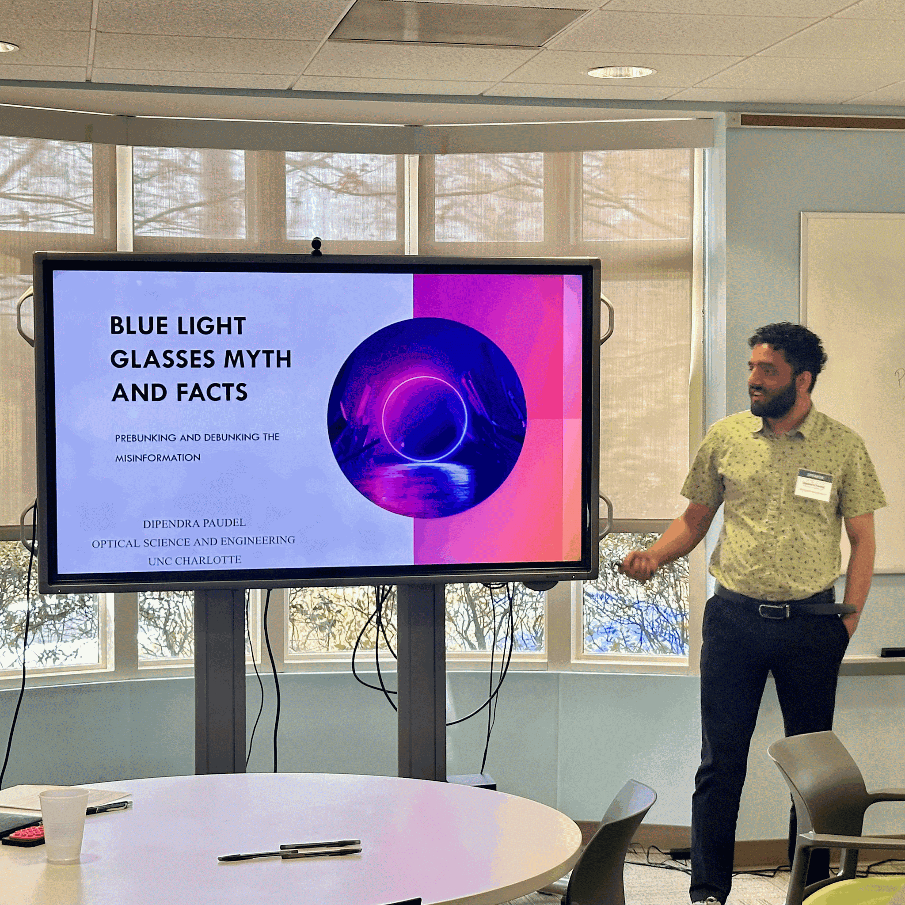
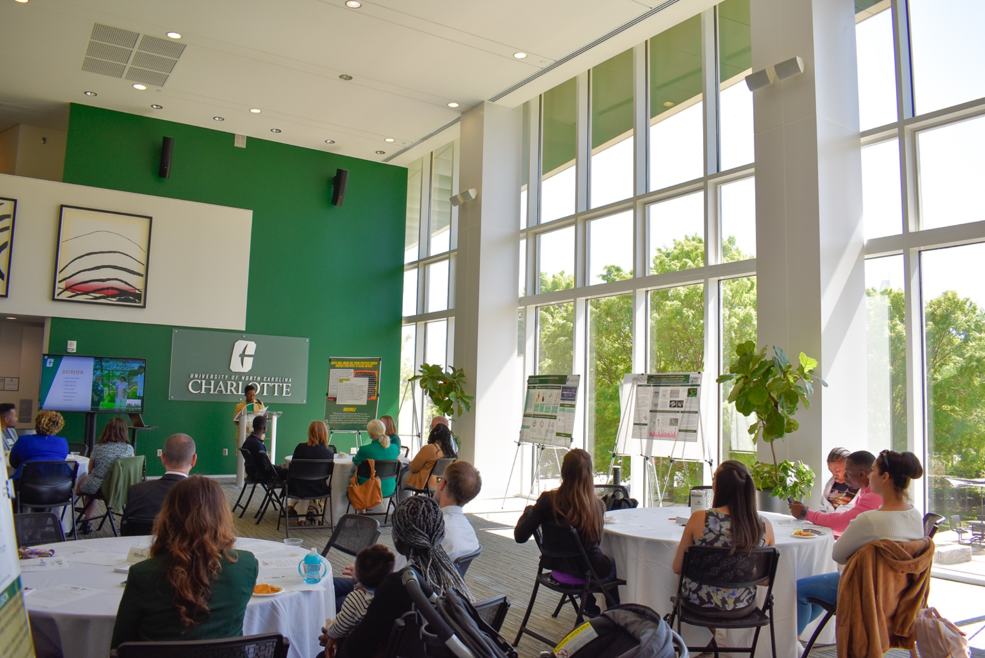
Enhanced by live events & workshops
Notes:
Adam
In addition to several synchronous, topical workshops, we offered 2 showcase events. In one students had the opportunity to present a short lightning talk to industry representatives. In the other students engaged in roundtable discussions with community members, nonprofit representatives, and city officials.

Slide 8
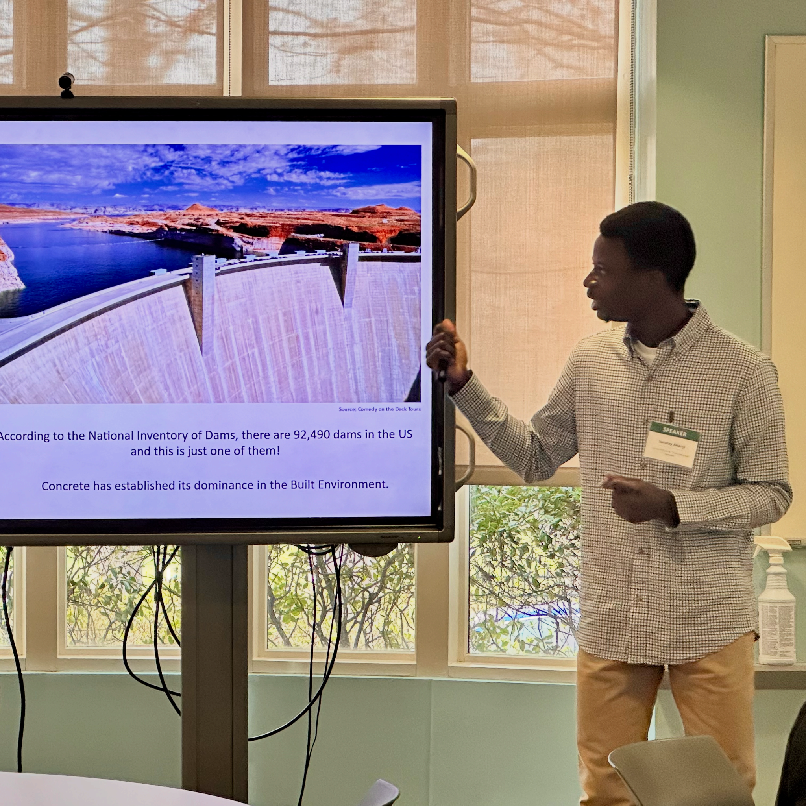
Study Participants
Final Cohort:
53 graduate students
92% full-time, 68% doctoral students
42% Asian, 32% White, 17% Black
64% women, 34% men
55% earned undergraduate degree outside of U.S. (international students)
Top program areas: natural sciences, computing & informatics, engineering & social science
Notes:
Elise
We ran the program for 2 years, yielding a final cohort of 53 graduate students. Our students came from a variety of STEM disciplines.

Slide 9
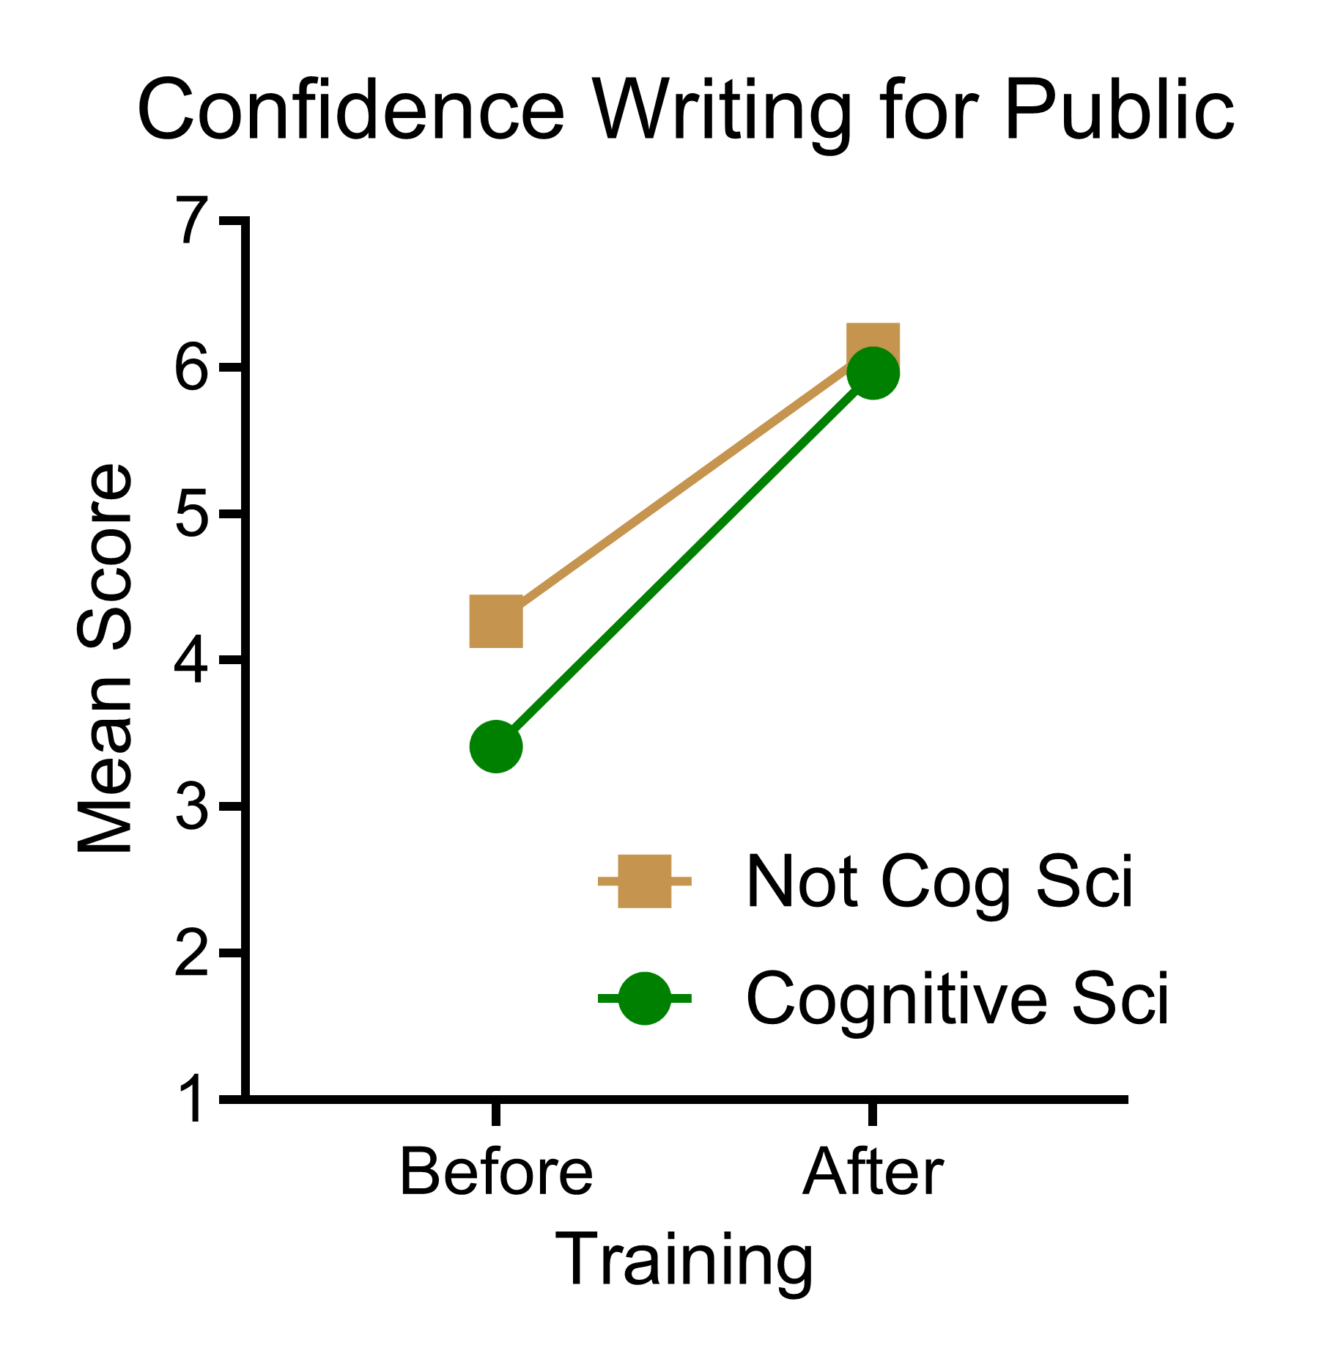
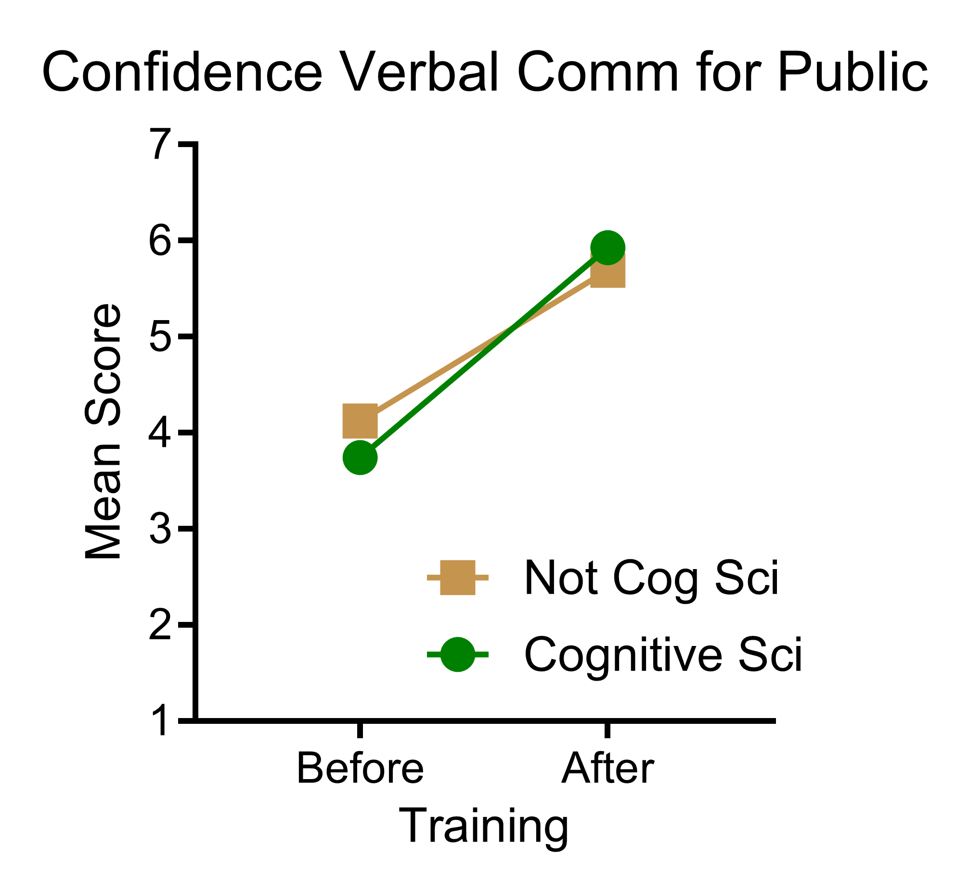
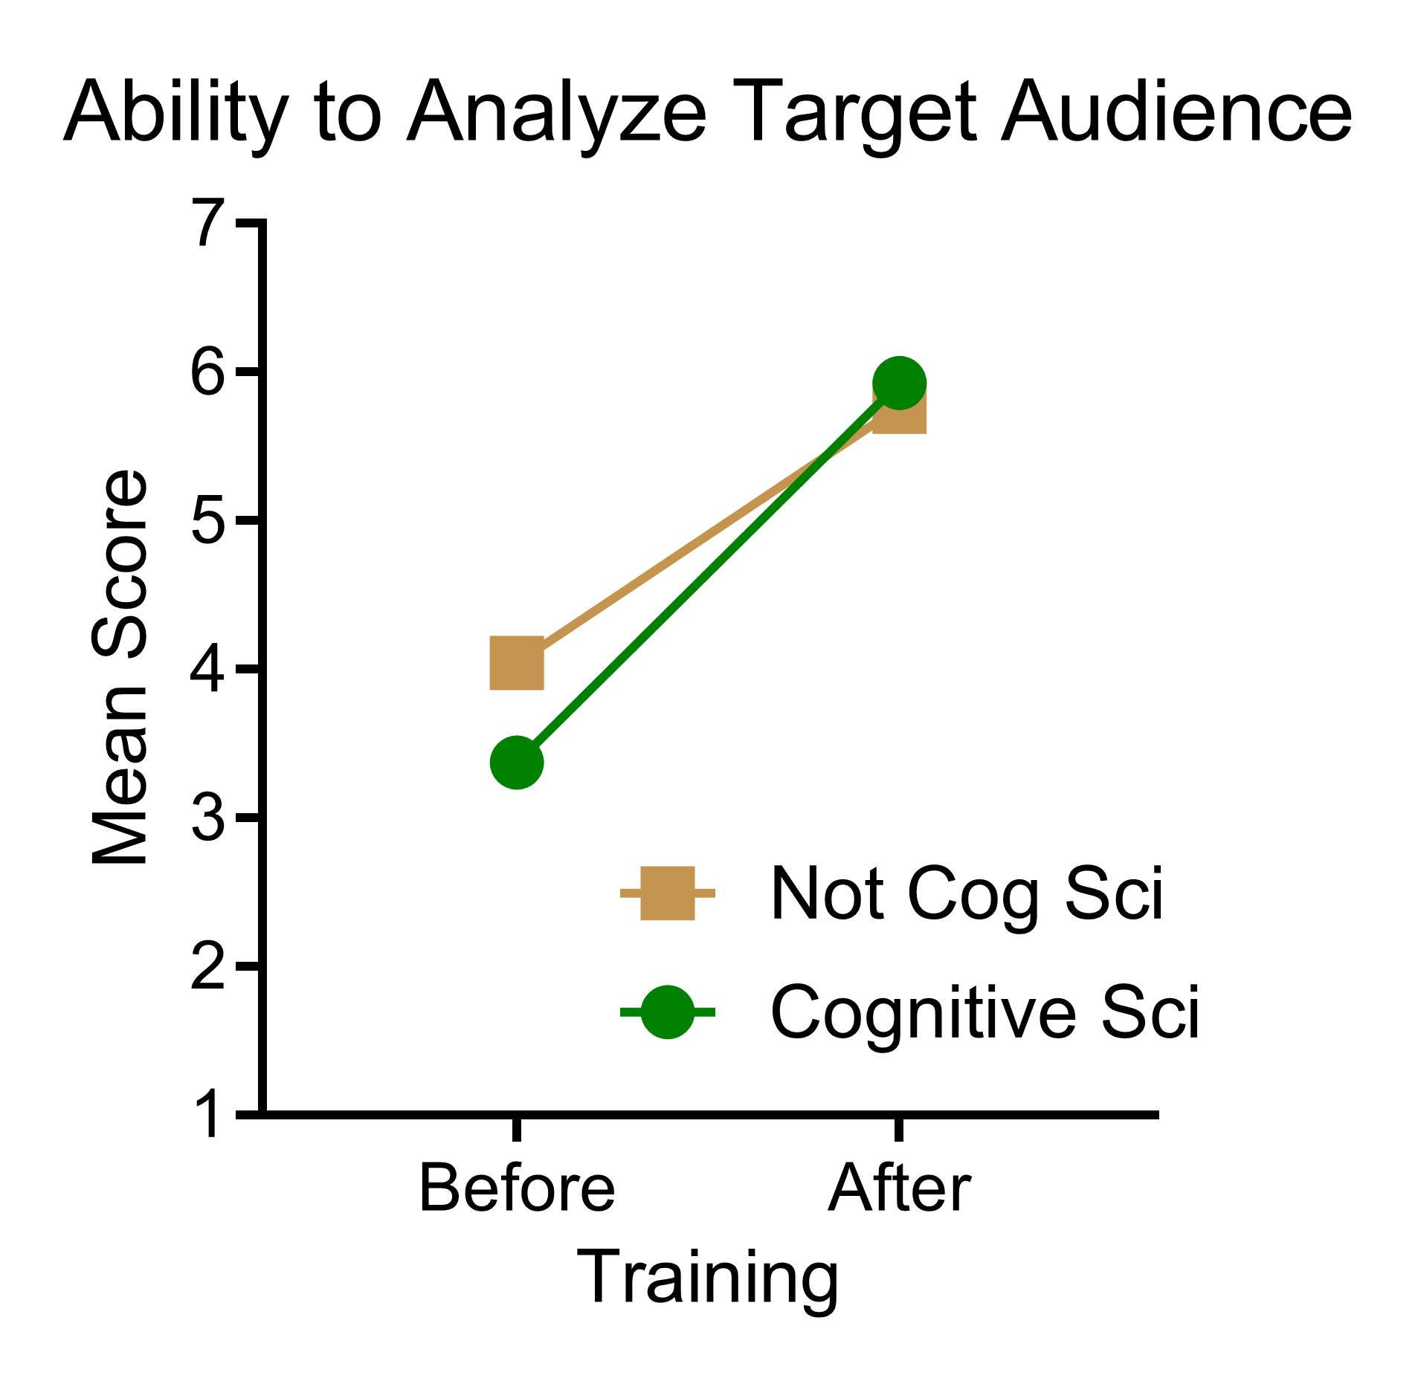
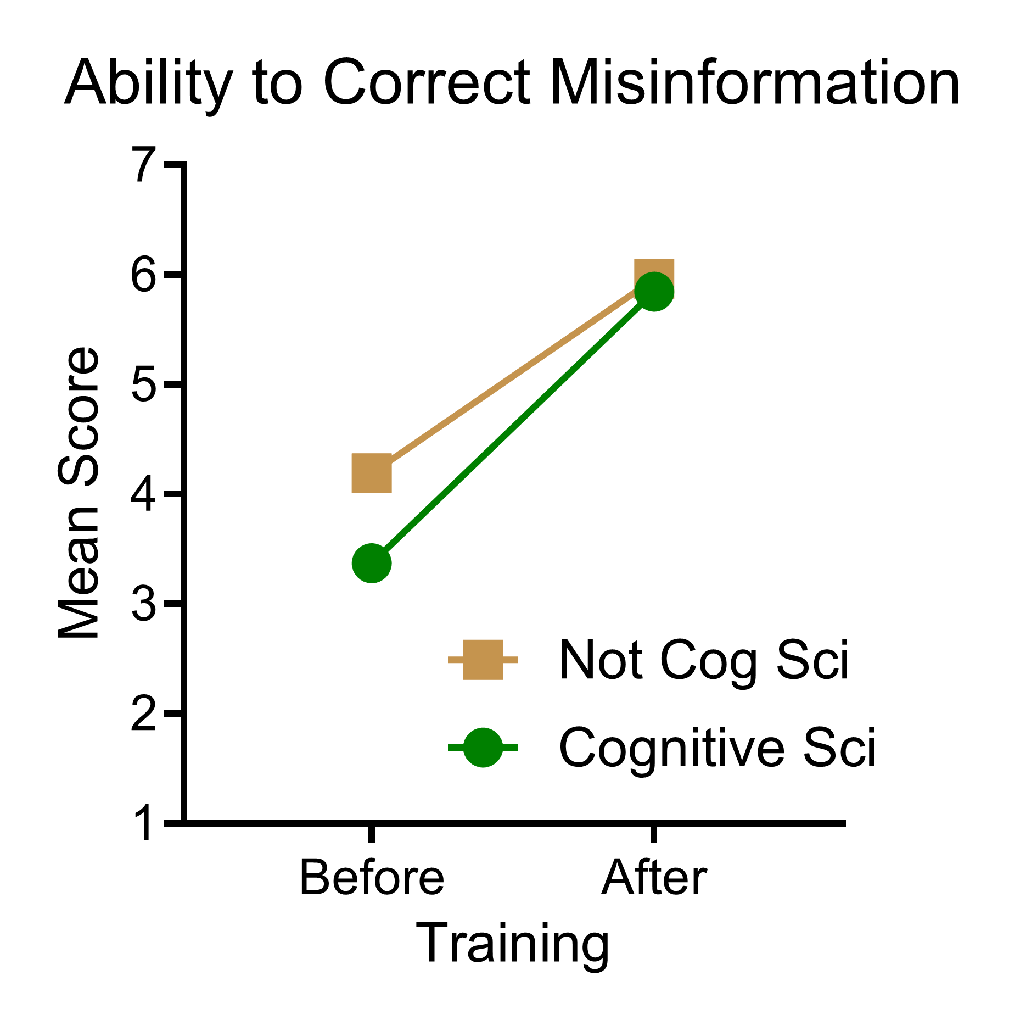
Pre- & Post-Survey Results
Students perceive gains in confidence & STEM communication abilities
Increases in confidence & abilities after training
Students starting with Cognitive Science Theories course show stronger training gains for some items (Group x Training interaction), but not all items
Notes:
Elise
We surveyed our participants to ask how they rated their confidence and ability levels before and after training. These are preliminary findings. We see strong increases in students’ self-perceived confidence in communicating STEM topics for the public and their perceived STEM communication abilities. We see some interactions between 2 groups and training, but we don’t see an overall clear difference between the students who started in the cognitive science course versus those who did not. We still need to dig into these data more rigorously.

Slide 10

Post Survey Results
Overall training quality rated Good to Excellent (4.6 out of 5, with 5 being excellent)
Overall workload rated Moderate (2.9 out of 5, with 5 being very heavy)
Notes:
Elise
Students were overall very positive in their view of the training quality, and rated the workload as moderate.

Slide 11
Qualitative Feedback
My favorite aspect of this training program was its practical, real world focus on communication. Instead of just theory, it emphasized how to actually apply concepts like simplifying complex ideas, structuring messages clearly, and engaging different audiences. The hands on activities and examples made it easy to connect what I learned to interviews, presentations, and professional communication.
I feel more confident using platforms like social media, videos, and even speaking opportunities to break down complex ideas in a way that actually makes sense to people. It also made me realize that communication isn’t just an add-on to research....it’s a responsibility. So moving forward, I do see myself being more intentional about engaging with the public and making my work more visible and accessible.
I think this training will help me in my future job search and career because it improved my communication skills in a practical way. I feel more confident now in explaining complex ideas clearly, thinking about the audience, and making information easier to understand. I also think these skills will help in interviews, presentations, and working with different kinds of people in a professional setting. Overall, it made me more aware of how important clear and responsible communication is.
Notes:
Adam
Quotes from student participants. Many students recognized that this training will be helpful as they enter the job market.

Slide 12
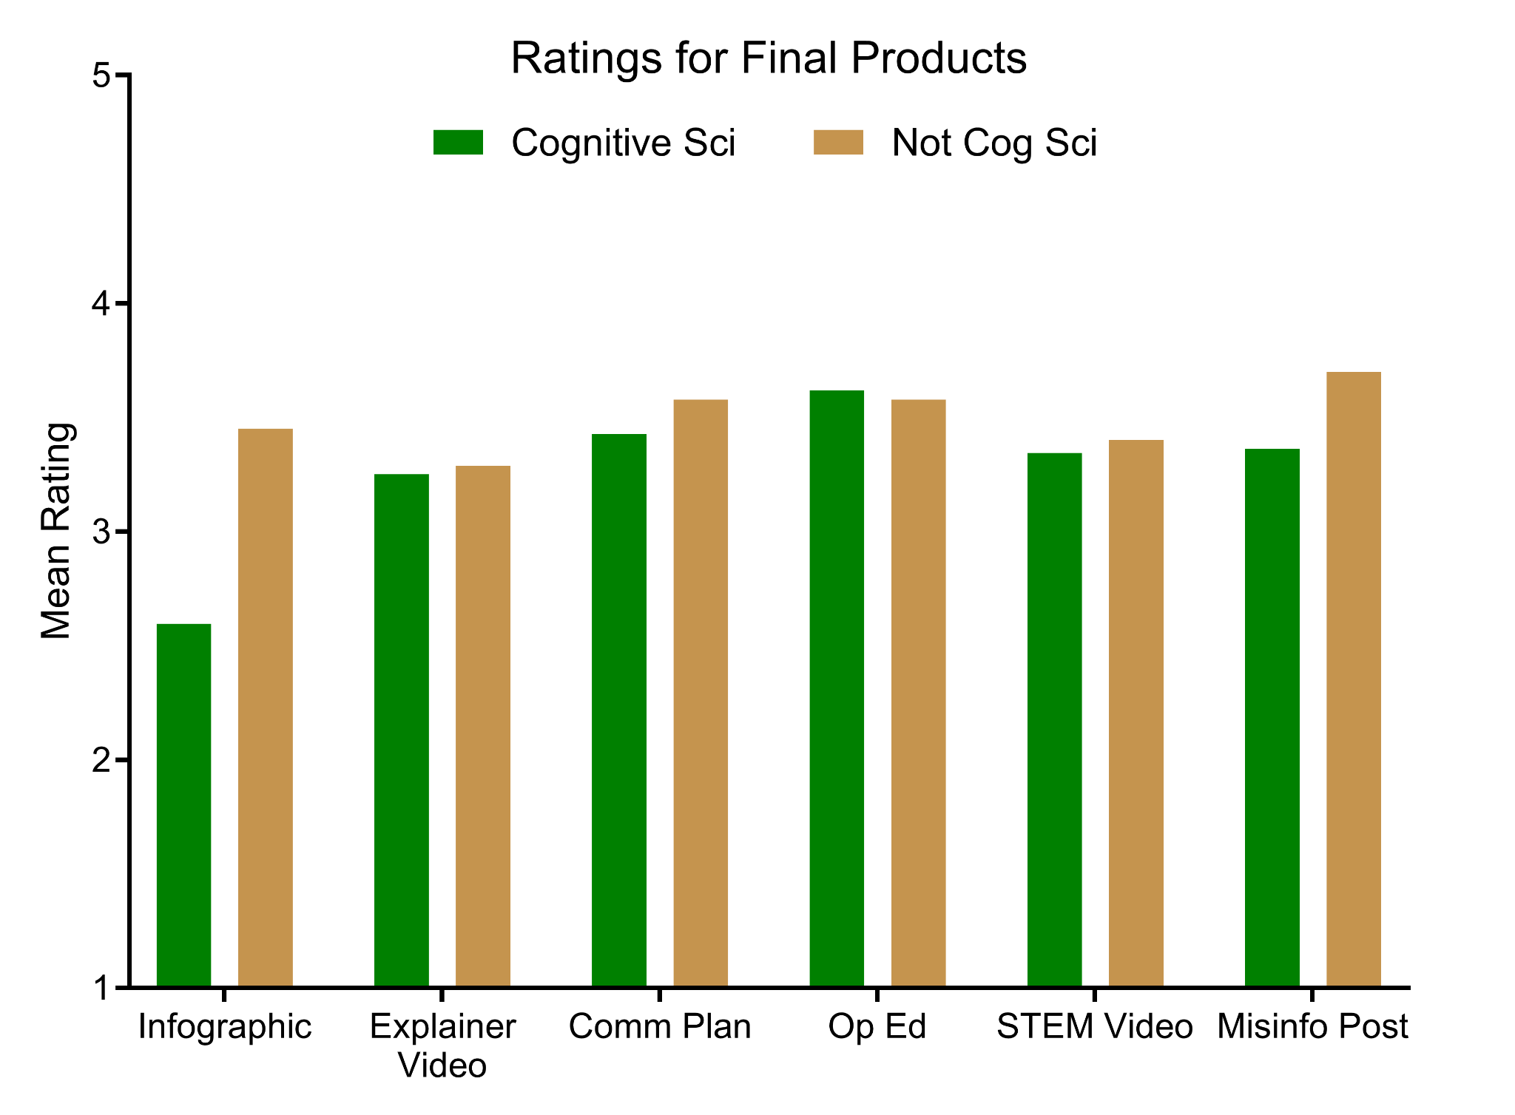
Rating Session Results
The final project for each module was evaluated by 2-3 faculty reviewers using rubrics we created.
The scale was from 1 (novice) to 5 (exemplary).
For all modules, students met expectations (rating of 3).
Two arms were generally similar performance, with some slightly higher scores in NCA.
Notes:
Adam
We hired faculty raters to review and rate students’ final products from each short course. The products were rated on a scale of 1 (novice) to 5 (exemplary). For all modules, students met expectations (ratings of 3). This was encouraging to see that in the context of an asynchronous short course, students were able to apply what they learned to these often-unfamiliar communication genres in effective ways.

Slide 13
Revisiting Research Questions
Minimal impact of cognitive science training on subsequent learning, but students say material was of high interest.
Training led to growth in students’ perceived confidence & ability to communicate STEM topics to public audiences.
Students’ products met raters’ expectations for demonstrating course & communication genre learning objectives.
Notes:
Elise

Slide 14


IGE Hub page & public website
Interesting in bringing this STEM Communication Training to your students free of charge?
We’re happy to share!
Six 4-week mini courses designed for asynchronous learning.
Courses can be mixed & matched or combined.
Content is modifiable & ready to be adapted to your LMS.
https://igehub.org/project/applying-cognitive-theories-of-learning-to-improve-graduate-training-in-stem-communication/
https://stem-comm.github.io/stem-comm-portal/
Notes:
Adam
Website created for long term sustainability and dissemination.

