Slide 1
The Writing SYSTEM: A Systemic Approach to Graduate Writing Instruction and Intervention
Russell W. Mailen*, Katharine Brown, Christopher Basgier, Jeffrey LaMondia, Sushil Adhikari
Auburn University
IGE Webinar on STEM Communication
*Award PI (rwm0028@auburn.edu)
NSF Innovations in Graduate Education Award #2224967
Presentation based on: Mailen et al., Evaluating Interventions Intended to Increase Self-Efficacy of Graduate Engineering Students as Professional Writers Paper presented at 2026 ASEE Annual Conference & Exposition, Charlotte, North Carolina. 10.18260/1-2--59553

Slide 2
Introduction
Writing requirements for graduate students in engineering
  Short-term: term papers and reports
  Intermediate-term: conference and journal papers
  Long-term: theses and dissertations
Writing requires students to synthesize knowledge from multiple domains
  Technical: classes, published literature, and their own research.
  Stylistic: writing process, genre, and rhetorical strategies
How writing is learned:
  Reading peer reviewed papers
  One-on-one ad-hoc mentoring from advisor
Research Goal
Determine the relationships among self-efficacy, self-regulation of writing, and writing ability in the context of engineering graduate education that includes systemic writing instruction and intervention structures.
Self-efficacy: The belief in one’s ability to complete a task successfully
Self-Regulation: the ability to monitor and manage your thoughts, emotions, and behaviors to achieve long-term goals and adapt to stressors

Slide 3
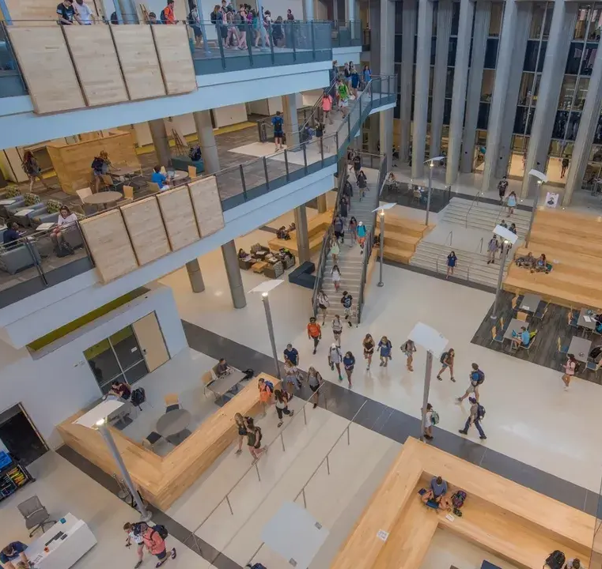

What is The Writing SySTEM?
Four interventions:
  Writing workshops: one-off events focused on writing and led by engineering faculty
  Discipline-specific writing courses: Elective 3-credit hour, graduate level course offering discipline specific writing instruction
  Peer writing groups: Social means of supporting students through communities of practice
  Open Educational Resource (OER): publicly available digital resources for writing instruction
Interventions led by engineering faculty
Project supported by Writing Across the Curriculum (WAC) program
Link to OER
(See tag “Writing SySTEM”)

Slide 4
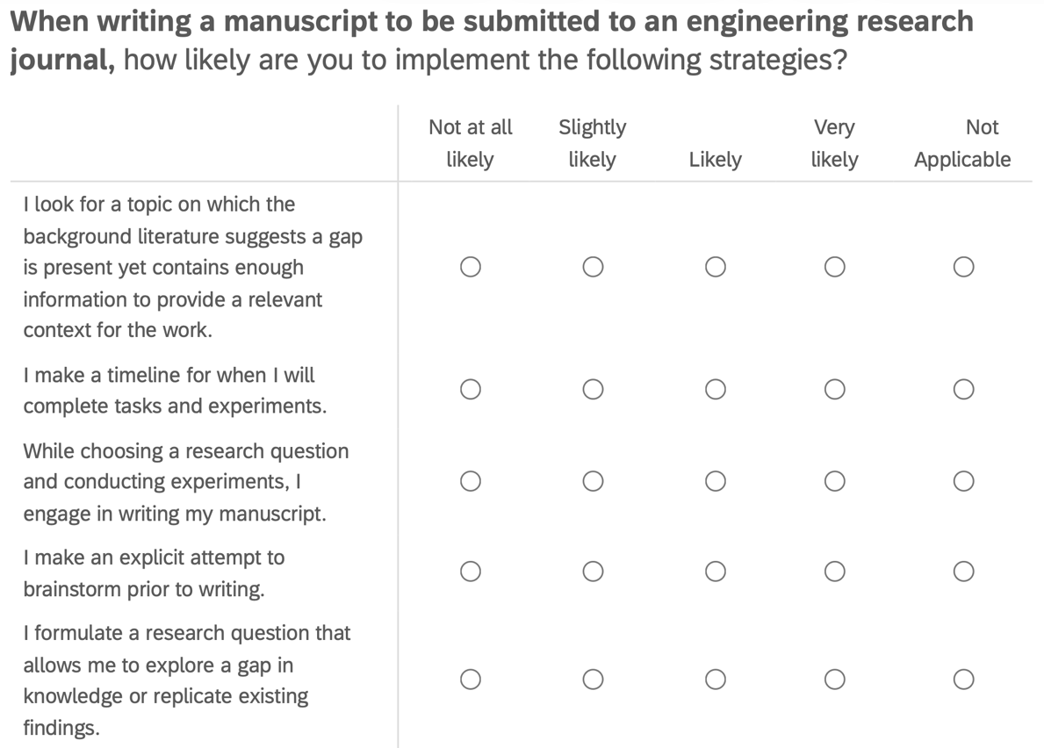
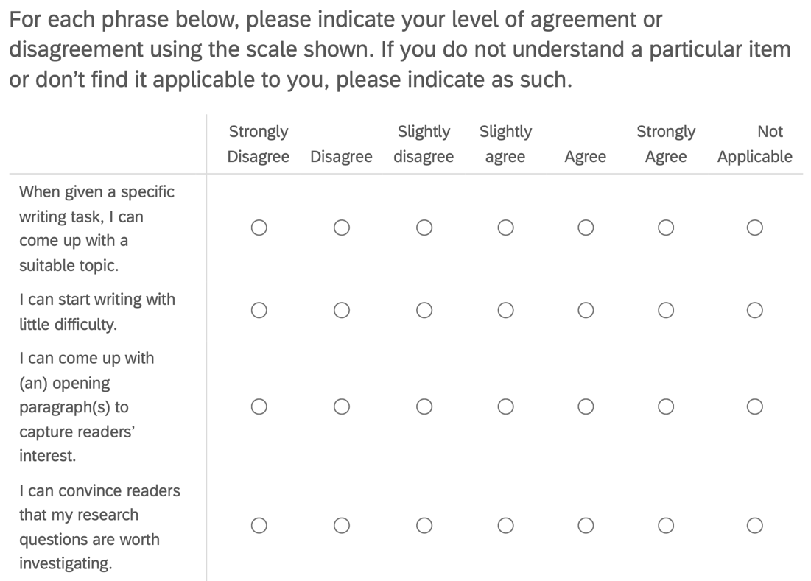
Evaluation
Metacognitive Strategy Knowledge Test (MSKT)
  Measures writing self-regulation strategies
Writing Self-Regulatory Efficacy Scale (WSRES)
  Measures writing self-efficacy and self-regulation
Semi-structured interviews
  Provide qualitative depth
Small sample size
  Aggregated results
  Anonymized data
Sample questions from MSKT (left) and WSRES (right)

Slide 5
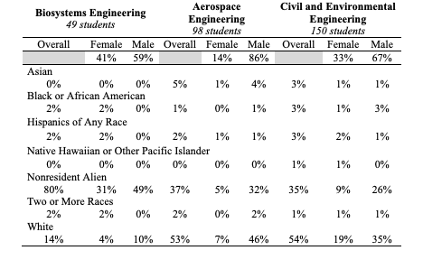
Context
Biosystems Engineering |  |  | Aerospace Engineering |  |  | Civil and Environmental Engineering
49 Students |  |  | 98 Students |  |  | 150 Students
Overall | Female | Male | Overall | Female | Male | Overall | Female | Male
 | 41% | 59% |  | 14% | 86% |  | 33% | 67%
Asian
0% | 0% | 0% | 5% | 1% | 4% | 3% | 1% | 1%
Black or African American
2% | 2% | 0% | 1% | 0% | 1% | 3% | 1% | 3%
Hispanics of Any Race
2% | 2% | 0% | 2% | 1% | 1% | 3% | 2% | 1%
Native Hawaiian or Other Pacific Islander
0% | 0% | 0% | 0% | 0% | 0% | 1% | 1% | 0%
Nonresident Alien
80% | 31% | 49% | 37% | 5% | 32% | 35% | 9% | 26%
Two or More Races
2% | 2% | 0% | 2% | 0% | 2% | 1% | 1% | 1%
White
14% | 4% | 10% | 53% | 7% | 46% | 54% | 19% | 35%
Carnegie R1 university
Three graduate programs:
  Biosystems Engineering
  Aerospace Engineering
  Civil & Environmental Engineering
Campus writing center
Small sample sizes, so results were not correlated to demographics

Slide 6

Participation
Period from February 2023 – December 2024
Workshops: 85 students
Writing courses: 51 students
Writing groups: ~20 students
Survey responses: 24 students
  11 from biosystems
  9 from civil
  4 from aerospace
Interviews: 24 participants

Slide 7
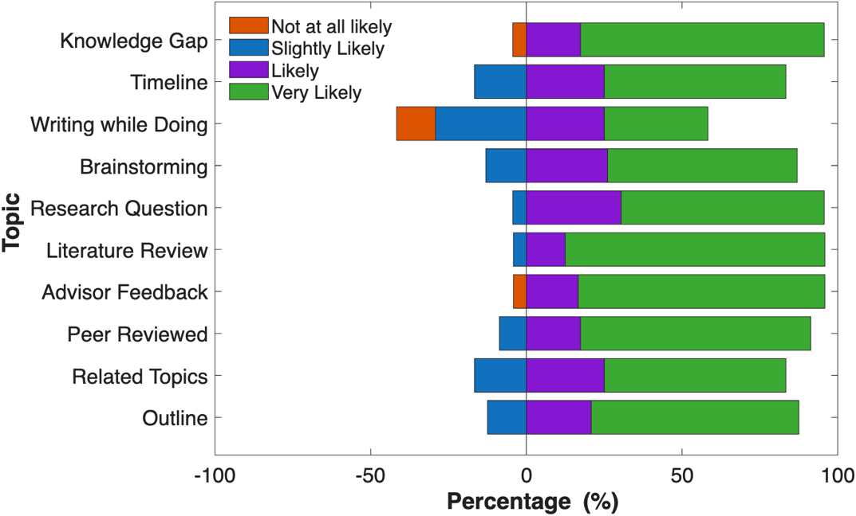
Results
Four categories:
  Pre-writing strategies
  Mid-writing adjustments
  Post-intervention adoption
  Self-efficacy
Results plots:
  Each row indicates a topic or strategy
  Each bar totals 100%
  Positive percentage for positive response
100 %
Topic/Strategy

Slide 8
Results: Pre-Writing Strategies
87.3% likely or very likely to use pre-writing strategies
High adoption:
  Literature review
  Advisor feedback
  Knowledge gap
  Peer-reviewed focus
Lower adoption:
  Writing while doing
Key insight: Writing often seen as a task for after research, not during

Slide 9
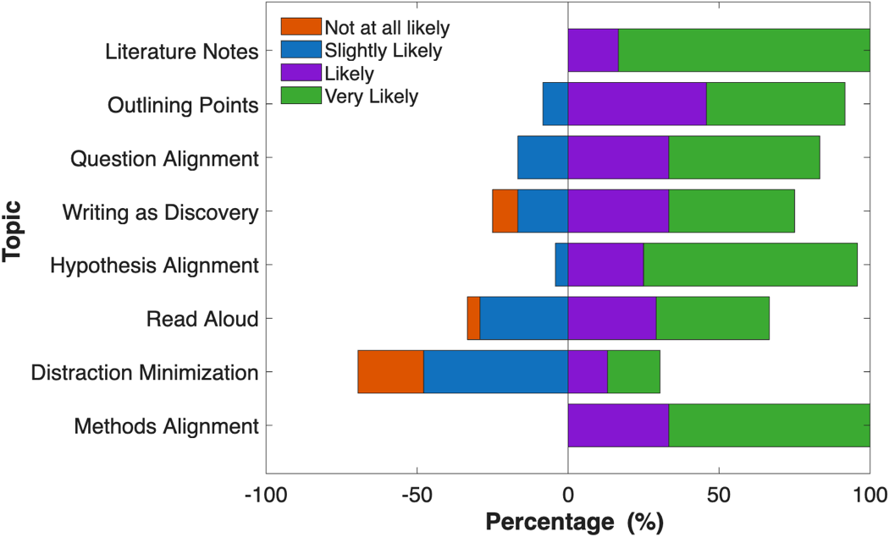
Results: Mid-Writing Adjustments
80.6% likely or very likely to use monitoring strategies
High Adoption:
  Literature notes
  Hypothesis alignment
  Methods alignment
  Question alignment
Low adoption:
  Distraction minimization
Key insight: Students struggle with writing environment and focus

Slide 10
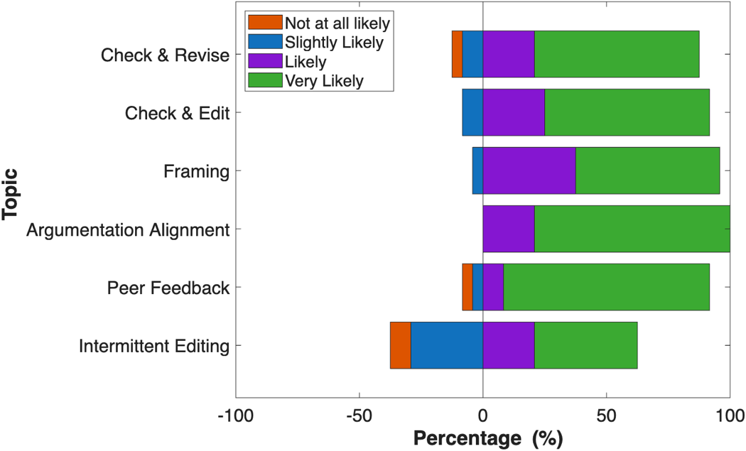
Results: Post-Intervention Adoption
88.2% likely or very likely to adopt strategies
High adoption:
  Peer feedback
  Argument alignment
  Check and revise
Low adoption:
  Intermittent editing
Key insight: Continued separation of writing and research workflows

Slide 11
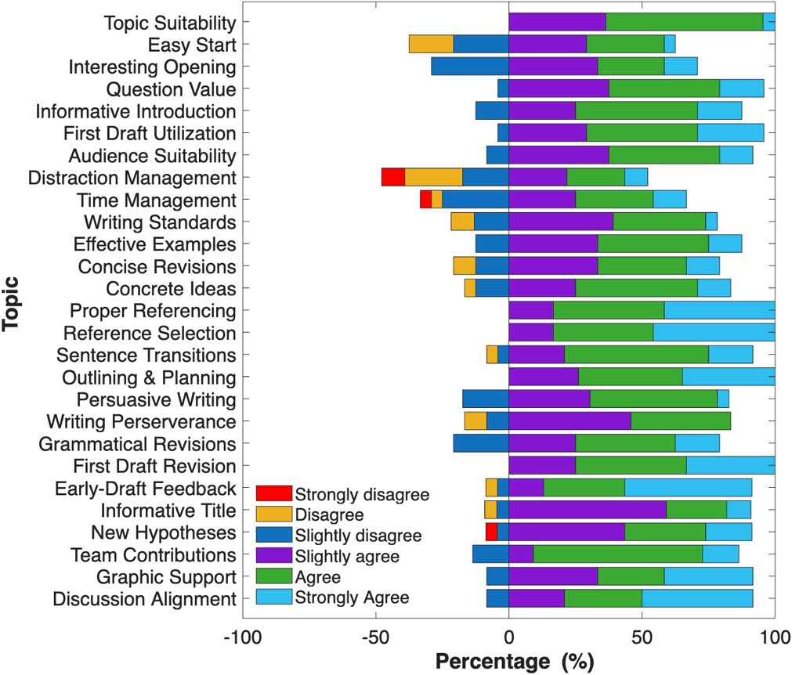
Results: Self-Efficacy
86.3% positive responses overall
Areas of high self-efficacy:
  Research and referencing
  Revision and planning
  Incorporating feedback
Areas of low self-efficacy:
  Managing time and distractions
  Initiating writing process
Key insight: students construct their sense of self-efficacy through social comparison and self-assessment of specific skills

Slide 12
Discussion
Writing courses appear most impactful
  “Significant progress” on a writing project
  (Number of strategies) x (Time)
  More accountability
Effective peer writing groups
  Creates accountability
  Helps manage distractions
  Promotes consistent writing
  Addresses four factors influencing self-efficacy
  Leans on students for sustainability
Common themes:
  Integration of iterative writing into the
  research workflow
  Time and distraction management
  Factors influencing self-efficacy:
  Previous successful experiences
  Compare others to oneself
  Community feedback
  Use of healthy emotional and psychological strategies
  A. Bandura, Self-efficacy:
  The exercise of control. (1997)

Slide 13
Conclusion
The Writing SySTEM is a systemic approach to technical writing education
Graduate students possess have a high sense of writing self-efficacy
Students were proficient at:
  Identifying gaps in the literature
  Monitoring their writing for content alignment
Opportunities exist for targeted instruction on:
  Managing distractions
  Integrating writing into the research workflow

Slide 14


Acknowledgements
NSF Innovations in Graduate Education (Award #2224967)
Vanessa Rosa – Science With Impact

